Slide 1
DS 301 Final Project
Andrew Maloney & Sonya Haan

Slide 2
Stage 1: Ask a Question
How is machine learning/deep learning used in traffic predictions?
Can we predict the flow of traffic for a given 5 minute interval?
What are the benefits of this project?
Minimize the negative impacts of road congestion
Economic loss
Environmental impact
Traffic fatalities/injuries
A 2017 study on congestion costs revealed that Los Angeles was the worst congested city globally where drivers spent 102 peak hours in congestion, equaling an average of 12% of their total drive time, the congestion in the city costing $19.2billion to the drivers and US economy.
Notes:
Sonya - will add more to this

Slide 3
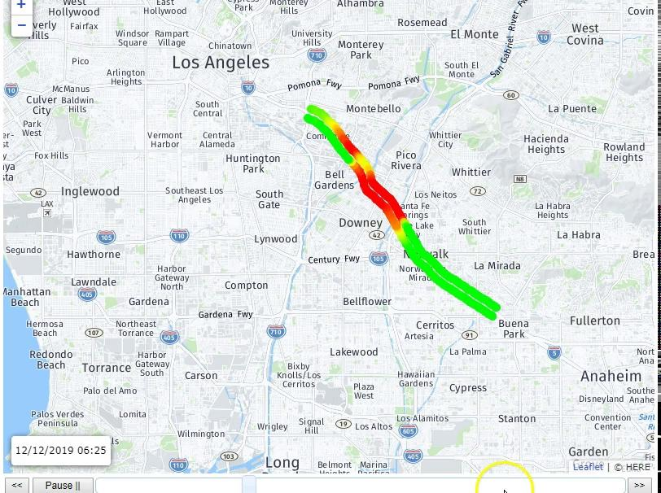
What is the Dataset?
California Department of Transportation records freeway traffic data through Vehicle Detection Stations (VDS)
VDS record Flow, Speed, and Occupancy of every 5 minute interval
Our dataset: 34 VDS along a stretch of I5-N in Los Angeles
2008 - 2013
Notes:
Sonya

Slide 4
Stage 2: Get the Data
Caltrans provides all Performance Measurement System (PeMS) data in a public archive
Zip files contain:
Aggregate data in Xls format
Lane-by-Lane in CSV format
Created folder in Google Drive to contain CSV files for each year
Imported data into Colab and concatenated all years into one Dataframe
Notes:
either

Slide 5
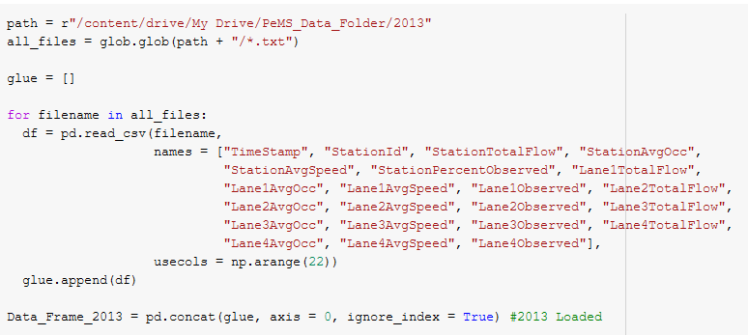
Load Data

Slide 6
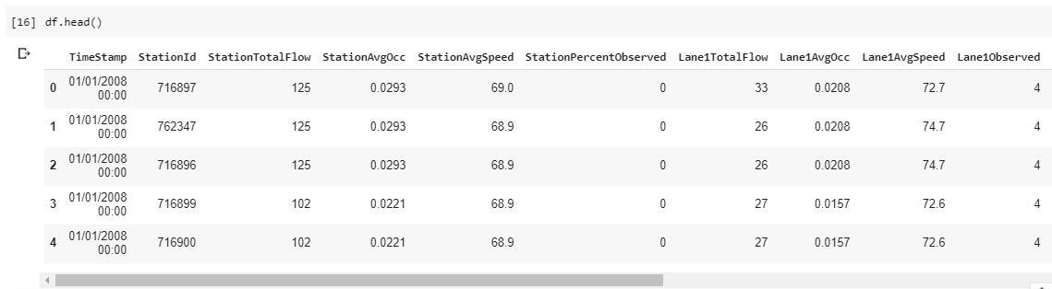
Original Dataframe
20,987,845 rows
22 columns
Same columns for Lanes 2,3,4

Slide 7

Handling the Data Size
Selected GPU as hardware accelerator
Increased RAM of Colab notebook
Utilized a memory reduction function

Slide 8
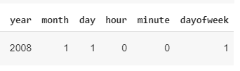
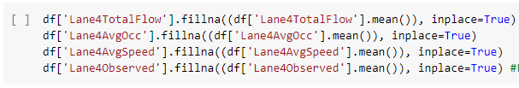
Cleaning the Data
Change ‘TimeStamp’ from object to datetime
Extract year, month, day, hour, minute, and dayofweek from ‘TimeStamp’
Missing values for lane 4
Notes:
either

Slide 9
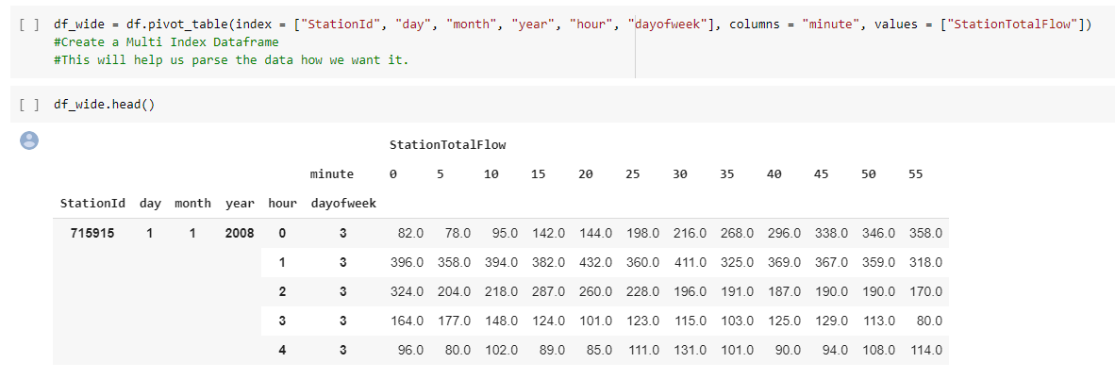
Reformat Data as Multi Index DataFrame
Notes:
Andy

Slide 10
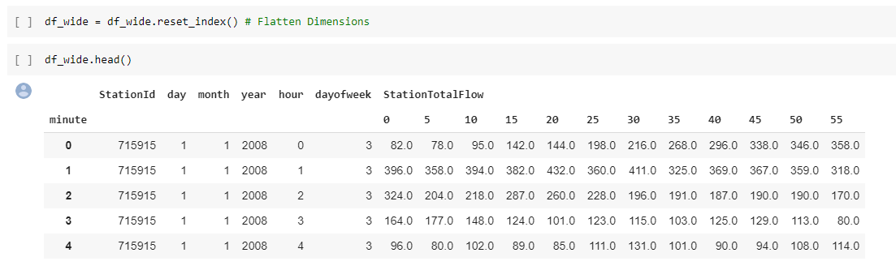
Flatten Dimensions of Multi Index DataFrame
Notes:
Andy

Slide 11
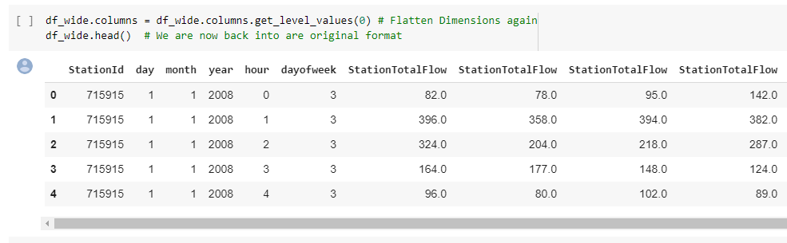
Flatten Dimensions Again
Notes:
Andy

Slide 12
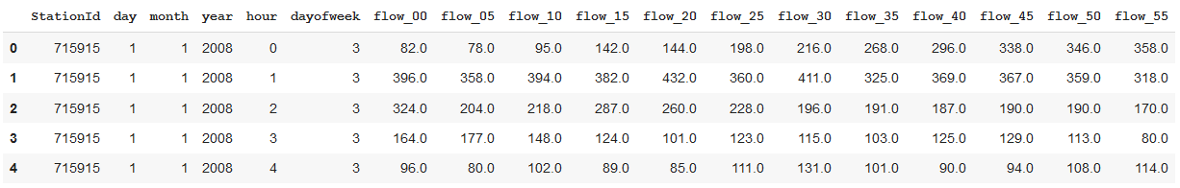
Correct Column Names

Slide 13
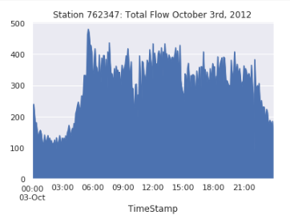
Stage 3: Explore the Data
Analyze how traffic flow changes throughout the course of the day
1:00 - 4:00 AM
Lowest flow values
5:00 - 6:00 AM
Highest flow values
Morning commute
11:00 AM - 3:00 PM
Lunch hour?
4:00 - 6:00 PM
Evening commute
Flow not as high as morning
Notes:
Sonya

Slide 14
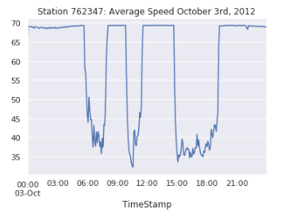
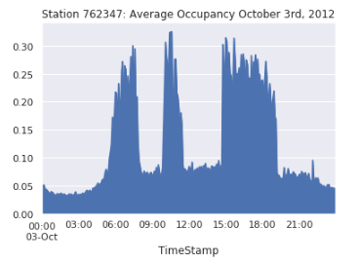
Speed and Occupancy Relationship

Slide 15
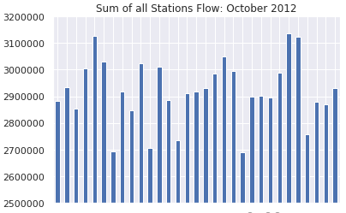
Flow Throughout the Month
Sundays have lower flow than other days of the week
Fridays have higher flow
2nd Wednesday?
Madonna concert in Los Angeles
M T W R F S S
M T W R F S S
M T W R F S S
M T W R F S S
M T W

Slide 16
Stage 4: Model the Data
When tackling this project there were many papers that we had to read in order to get an understanding of how are data and models will work together.
The models on the next slides are just a few we have chosen from many different types. HyperParameter tuning became a time consuming process which yielded improvement but not as much as we thought it would.

Slide 17
Feature Engineering
Categorical Variables were One-Hot Encoded
Data was split into Training and Validation Sets
A large Random Seed was used when splitting
Training Data was scaled using Sklearn Normalizer()
X_train, X_test, y_train, y_test were transformed into higher dimensional arrays depending on the model

Slide 18
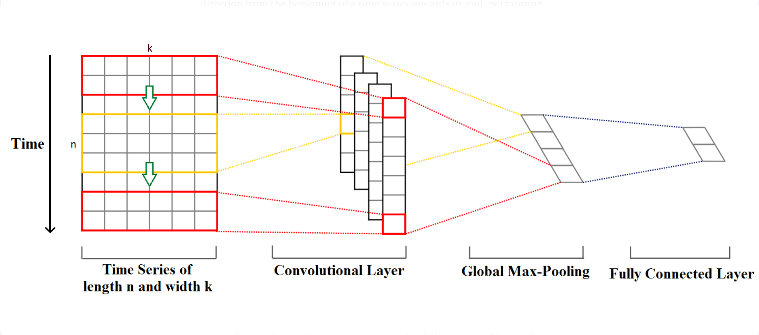
Convolutional 1D Concept

Slide 19
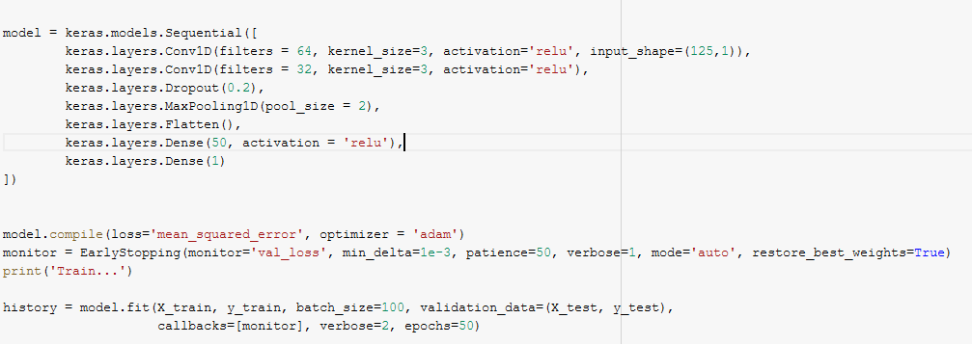
Convolutional Neural Network
Model Description:
1. Number of input Parameters: 125
2. Number of output Parameters: 1
3. Number of Hidden Layers: 1
4. Hidden Unit: 50
5. Tested Batch_Sizes: 25, 50, 100
6. Number of Epochs: 50
7. Activation Function: ReLU

Slide 20
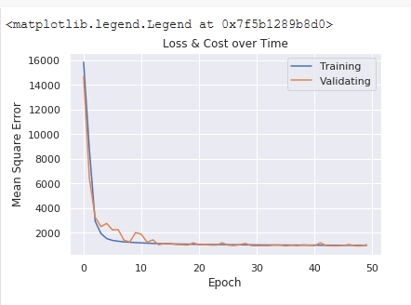

CNN Results
Description of Results:
From the graph we can see a good fit between the training and validation loss. Something we would like to see is a more defined generalization gap. Overall it is a good fit.
Standard Deviation of target variable(flow_55): 150
Based on our RMSE and MAE scores we can conclude that our model is learning a lot better than just memorization or guessing.

Slide 21
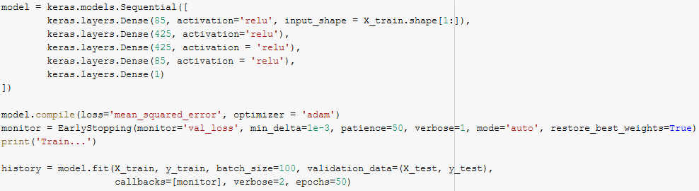
Dense Neural Network
Model Description:
1. Input Parameters: 125
2. Output Parameters: 1
3. Hidden Layers: 4
4. Hidden Units: 85, 425, 425, 85
5. Batch_Size: 25, 50, 100
6. Number of Epochs: 50
7. Activation Function: ReLU

Slide 22
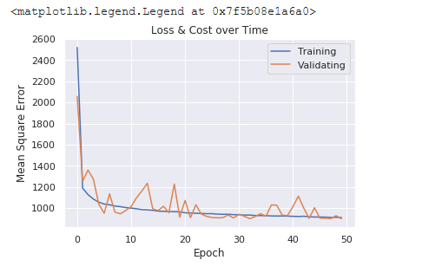

DNN Results
Description of Results:
From the graph we can see a problem with the fit between the training and validation loss. There are a couple common reasons for this noisy validation loss curve. It can be a result of the validation dataset. There might not be enough testing data for this models architecture.
Overall the relative noise isn’t serious and the RMSE and MAE scores still show this models ability to learning from the information we have given it.

Slide 23
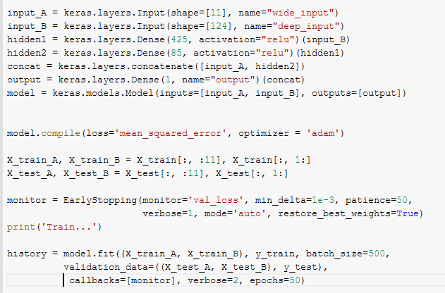
Complex DNN using Functional Api
Model Description:
1. Inputs:
A: for learning general patterns
B: for learning more complex patterns
2. Outputs: 1
3. Hidden Layers: 2
4. Hidden Units: 425, 85
5. Concatenation Layer: 1

Slide 24
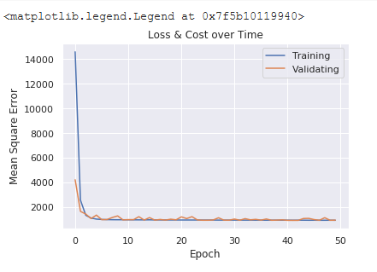
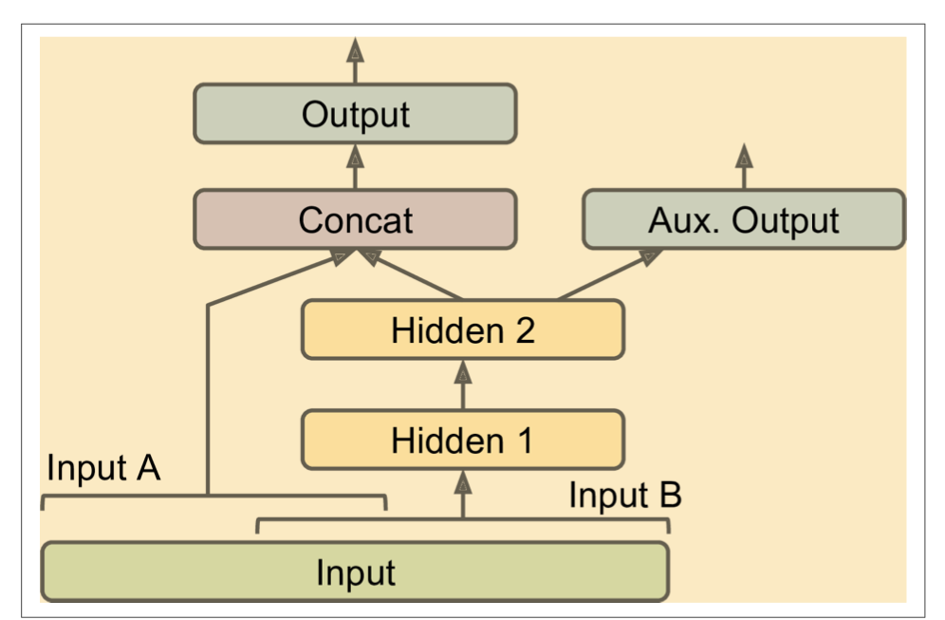
Complex DNN Results
Results look promising!

Slide 25
Necessary Changes For a Better Model
During the creation of our models we saw many results that were similar.
This led to the conclusion that Hyper Parameter Tuning wasn’t going to improve our models.
What needs to be done in order to achieve better results is how we feature engineer our categorical variables.
Entity Embedding and/or fourier transforms seem to show the most promising success based on other papers.

Slide 26
Work Cited
https://www.ncbi.nlm.nih.gov/pmc/articles/PMC6539338/pdf/sensors-19-02206.pdf
https://arxiv.org/pdf/1703.01006.pdf
https://github.com/ageron

Slide 27
Code Links
Code for Models
https://colab.research.google.com/drive/1E3OqPn8PkFa9cosfpB9_MpwFrwEkbRAY
Code for Graphs
https://colab.research.google.com/drive/1pVWdJE8KYum600dm3UrZjfs7UusqtsaJ
Google Drive Link https://drive.google.com/drive/folders/1fp-8zmgPU3wUblEGvpai5z4dQhp9xOvC?usp=sharing

